Slide 1
Uph Simulation state 01.09.2015

Slide 2
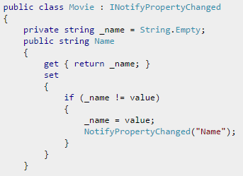
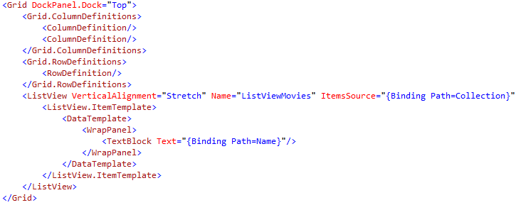
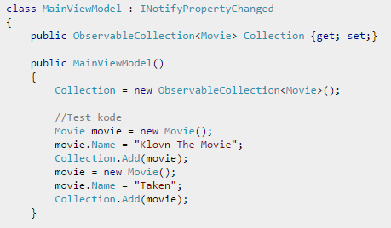
MVVM example
Model
Notification
View
Databinding
ViewModel

Slide 3
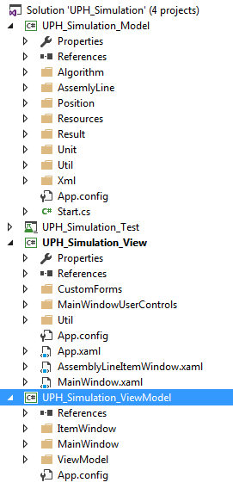
MVVM architecture project dependencies
View
Model
ViewModel

Slide 4
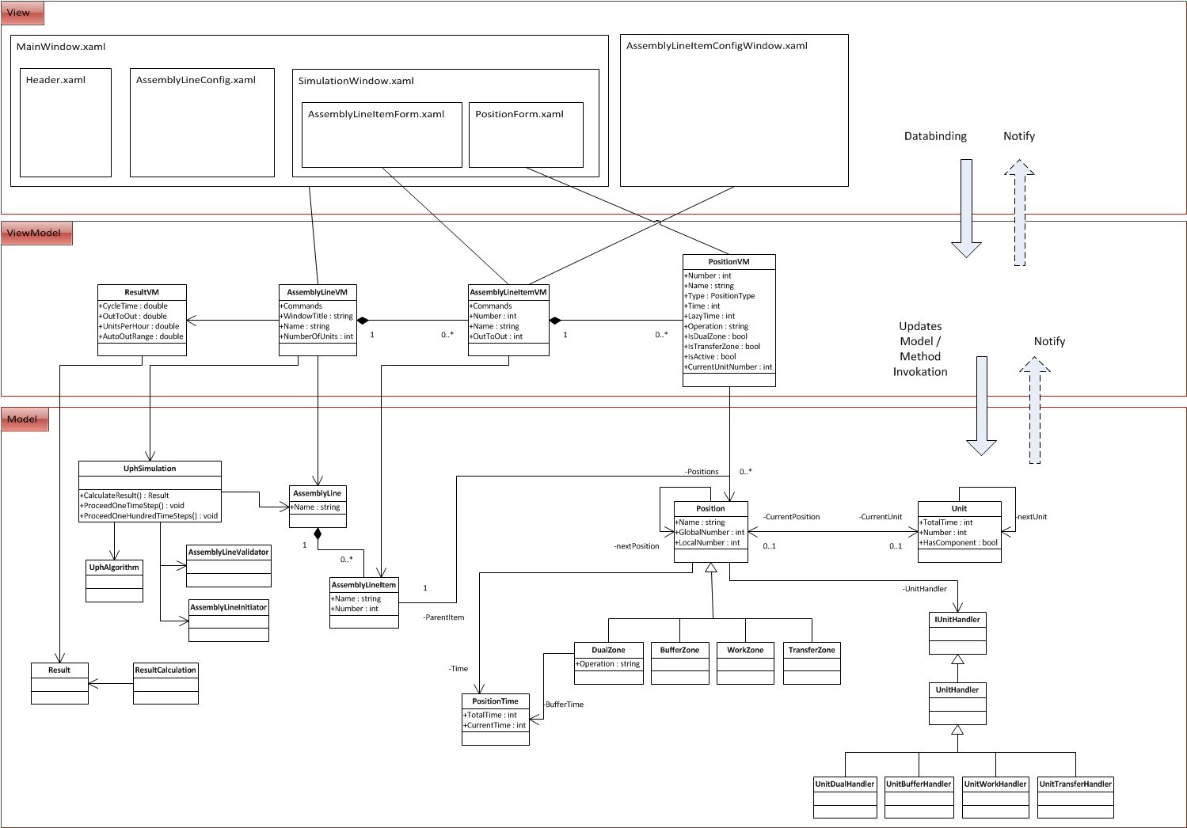

Slide 5
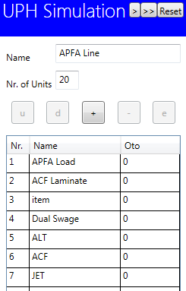
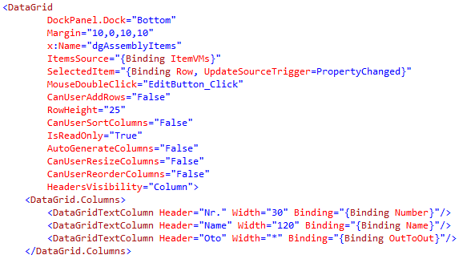
View
View
AssemblyLineItem
Up()
AssemblyLineItemVM
Up()

Slide 6
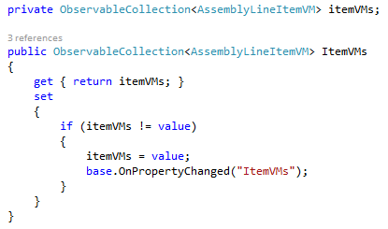
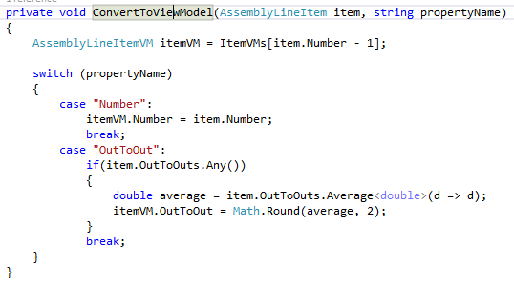
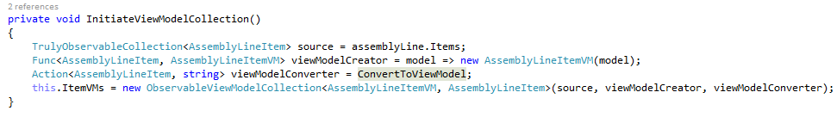
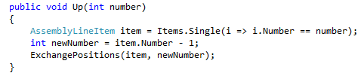
ViewModel ObservableViewModelCollection<VM, M>
model
viewModelCreator / viewModelConverter
View
AssemblyLineItem
Up()
AssemblyLineItemVM
Up()

Slide 7
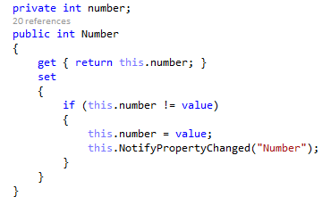
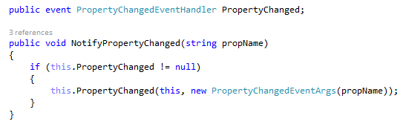
Model
View
AssemblyLineItem
Up()
AssemblyLineItemVM
Up()

Slide 8
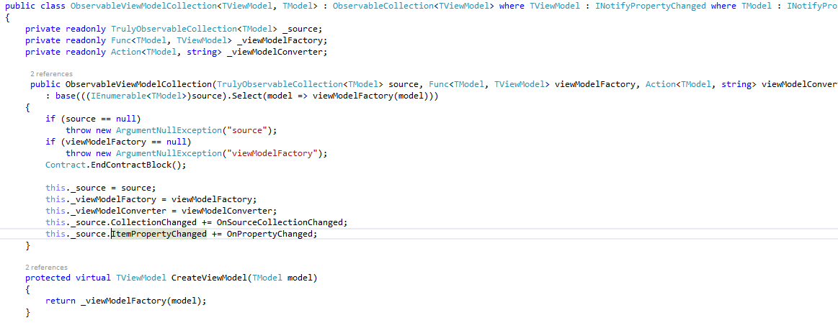


ObservableViewModelCollection<VM, M>
Collection in Model
Handler defined in ViewModel
Register Handler for ItemPropertyChanged fired by TrulyObservableCollection
View
AssemblyLineItem
Up()
AssemblyLineItemVM
Up()

Slide 9
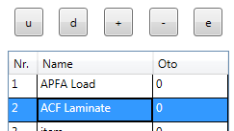
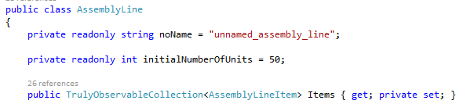
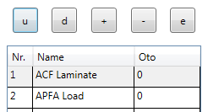
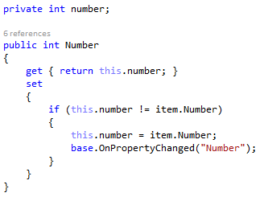
Flow
2. Command Up executed
3. Item changes Number
4. Number fires NotifyPropertyChanged
1.Press Button up
5. TrulyObservableCollection executes Handler
7. UI reacts on Notify and changes Number
and Table
6. item.Number fires NotifyProperyChanged
View
AssemblyLineItem
Up()
AssemblyLineItemVM
Up()

Slide 10
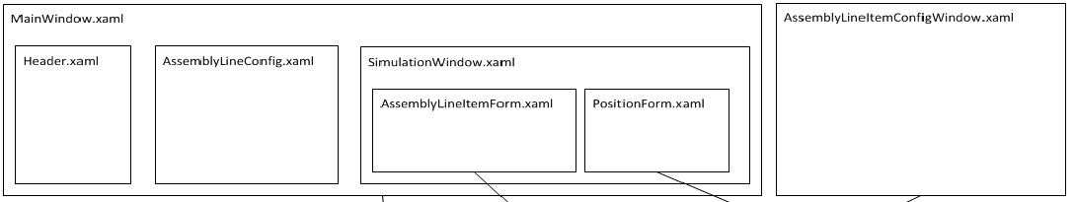
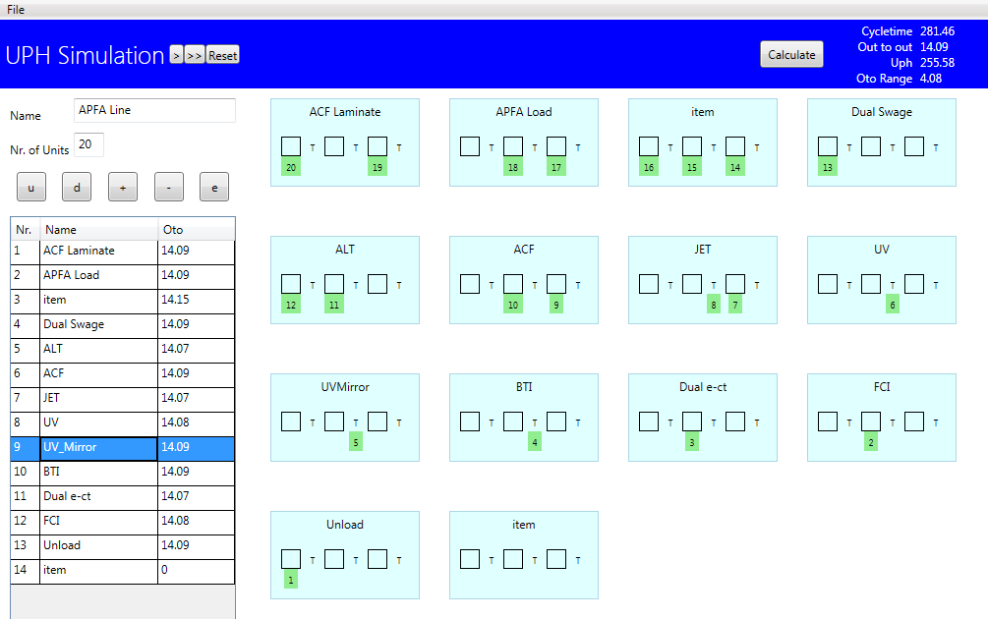
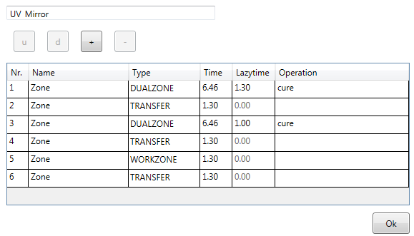
User Interface

Slide 11
end

